Slide 1
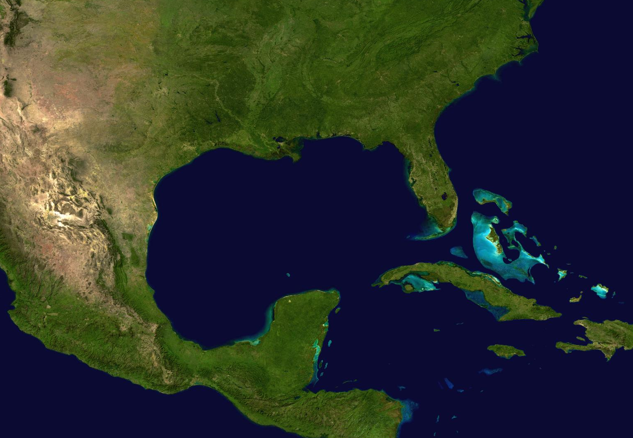
Offshore Notification System
1-888-910-4853
www.GulfSafe.org

Slide 2
GulfSafe -- Offshore Damage Prevention and Notification System
Designed to:
Eliminate preventable damage to subsurface infrastructure in Gulf of Mexico and Straits of Florida
Provide the same safe operating environment to offshore and onboard workers provided to onshore workers
Minimize environmental impact by preventing damages and quickly informing facilities owners when damages do occur so they can be quickly contained

Slide 3
GulfSafe is Needed to Protect Vast Infrastructures in Gulf
Extent of Oil and Gas Facilities (NOAA stats 2014)
More than 3,000 active wells
Over 25,000 miles of active oil and gas pipelines
More than 18,000 miles of “out of service” pipelines
Submerged cables for electric and communications lines, water and sewer pipes supporting offshore activities
Continuously Expanding

Slide 4
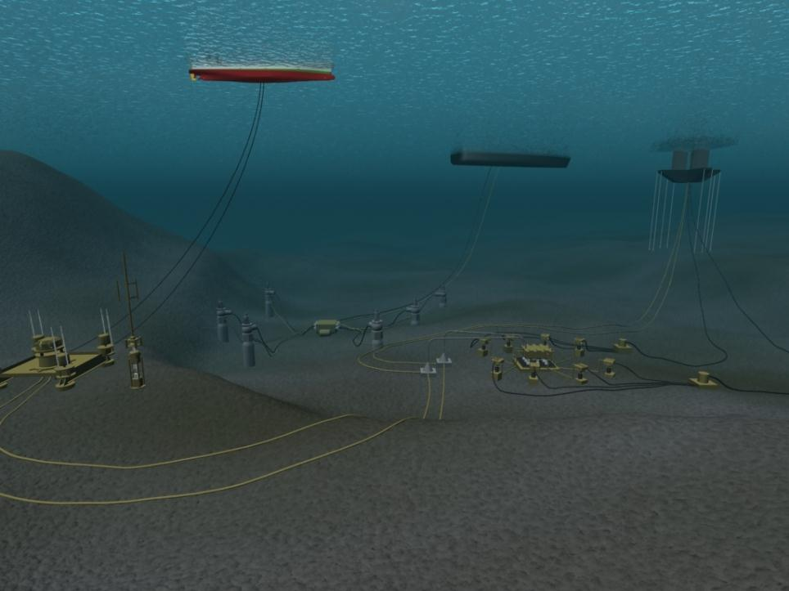
Lines from each platform extend over 18 miles in each direction, in extreme instances over 50 miles
Shifting lines and extensive umbilical lines beyond the site of the platform provide an extensive network needing protection

Slide 5
Benefits to Participating in GulfSafe
Reduce risk, damages, releases and repair costs
Increase worker safety
Cost effective protection of assets in Gulf of Mexico
  Reduction in insurance premiums may offset cost of GulfSafe
Publicly demonstrates efforts to enhance public safety and protect environment, workers and facilities

Slide 6
Which Utilities Should Participate
Offshore Oil and Gas Operations
Submerged Oil and Gas Pipelines
Wind Turbine Electric Generation
Offshore Electric Generation
Sewer and Water for near shore islands
Submerged Electric and Communications Lines

Slide 7
2015 Enhancements
Texas811 repurchased GulfSafe and brought it up to top industry standards
Upgraded to GeoCall v3 – the state-of-the-art notification processing software used at Texas811
Simplified Rate Plan
Established Link with National Hurricane Center

Slide 8
How to Request a Locate
Online at www.gulfsafe.org
Call 888-910-GULF (4853)
Through local one call centers: Texas811, Alabama811, Mississippi811 and Sunshine811 (Florida)
Information on work site will be submitted to GulfSafe members with facilities near where you will be working
Representatives from these facilities will contact you and have lines marked within10 days

Slide 9
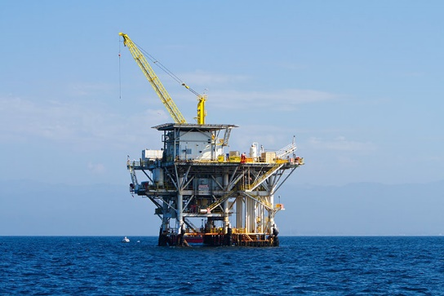
Onshore 811
Offshore GulfSafe.org

Slide 10
For Additional Information
www.gulfsafe.org
Buds@gulfsafe.org

