Slide 1
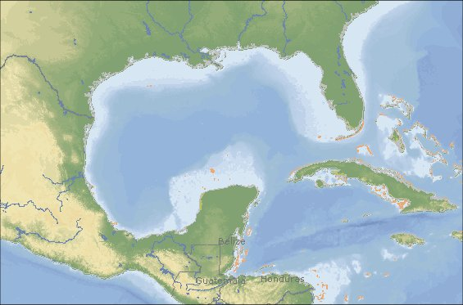
GulfSafe Notification System
1-888-910-GULF
www.gulfsafe.com

Slide 2
GulfSafe

Slide 3
Advocacy Group Perspective
Offshore workers should be afforded the same protections that onshore workers are given.
How can Operators and Regulators justify having thousands of miles of pipelines without a One Call to protect them?
Industry should take environmental protection more seriously.

Slide 4
Operators Perspective
Insurance reduction may offset the cost of GulfSafe
Reduce risk, damages, releases, repair cost.
Improve industry image.
Improve communication, verifiable communication.
Worker Safety
Improves Protection for the Environment

Slide 5
Government Perspective
Can be a tool to meet current notification requirements of working within 500 feet of another facility. Notifications through GulfSafe are verifiable.
Existing processes are working?
Encourage any attempts at improving safety.
May help insure consistent production (Royalties)
Reduce releases thereby protecting the environment.

Slide 6
Why GulfSafe?
Provides one seamless system from State to Federal Waters
Cost Effective Process
Data is updated weekly, daily if necessary.
Engineered to meet the demands of industry for decades to come.

Slide 7
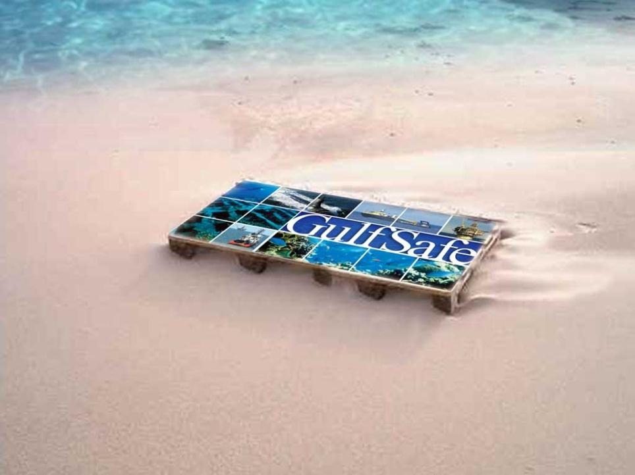
GulfSafe.com
Members
Offshore Oil and Gas Operations
Wind Turbine Electric Generation
Offshore Electric Generation
Sewer and Water for near shore Islands
Long Distance Companies
Miscellaneous and Government Entities

Slide 8
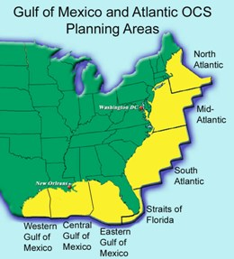
New leases have been Mapped for Virginia and South Carolina Coasts
The system is easily adaptable for the Pacific Coast and Alaska

Slide 9
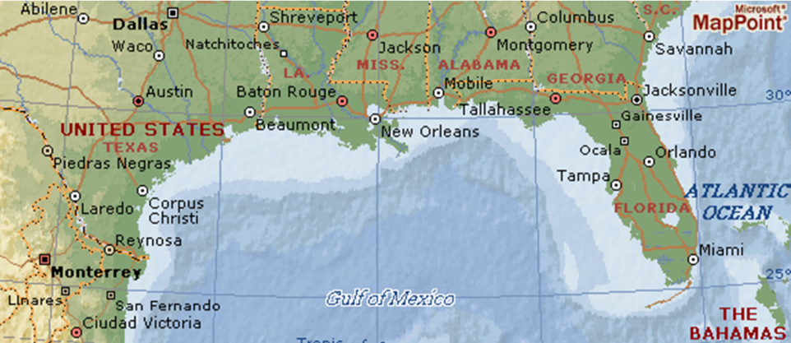
Working With Other One Calls

Slide 10
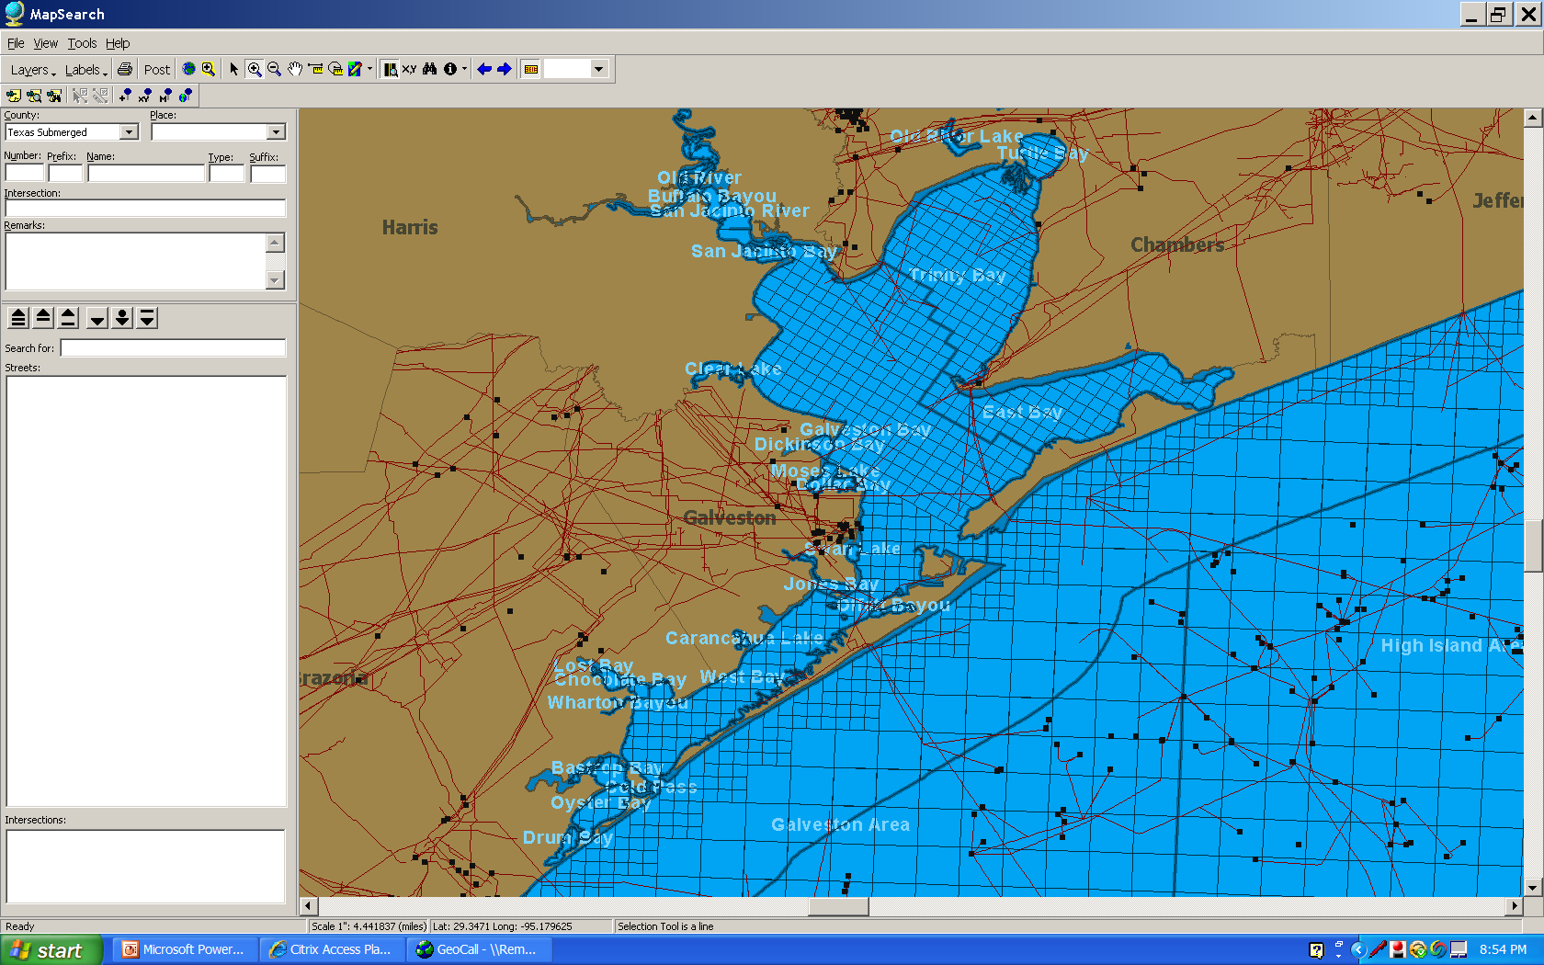

Slide 11
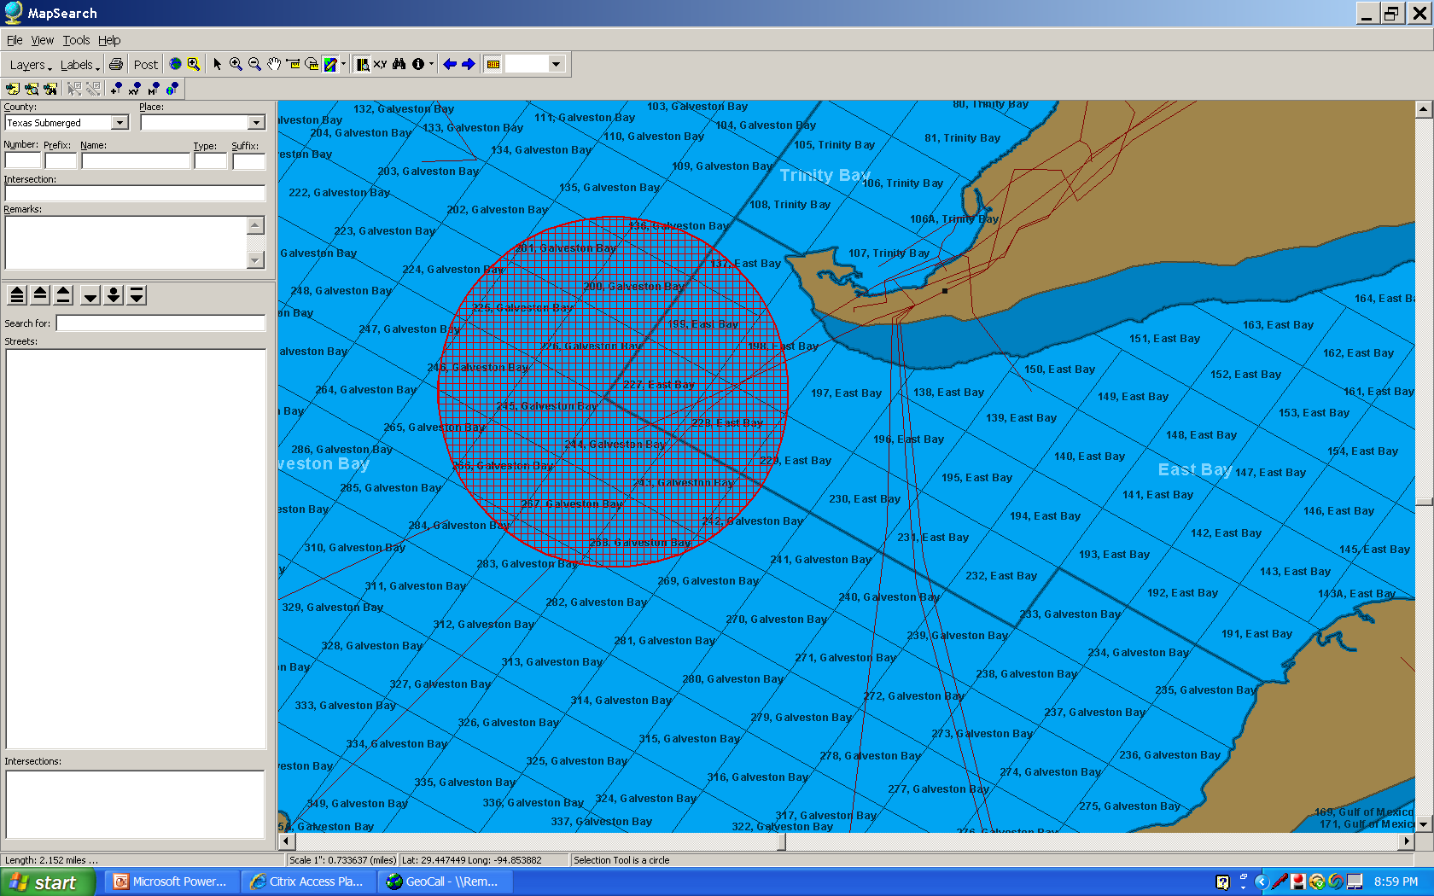
Once GulfSafe becomes rule it could easily and quickly be used by the USCG in oil spill response.

Slide 12
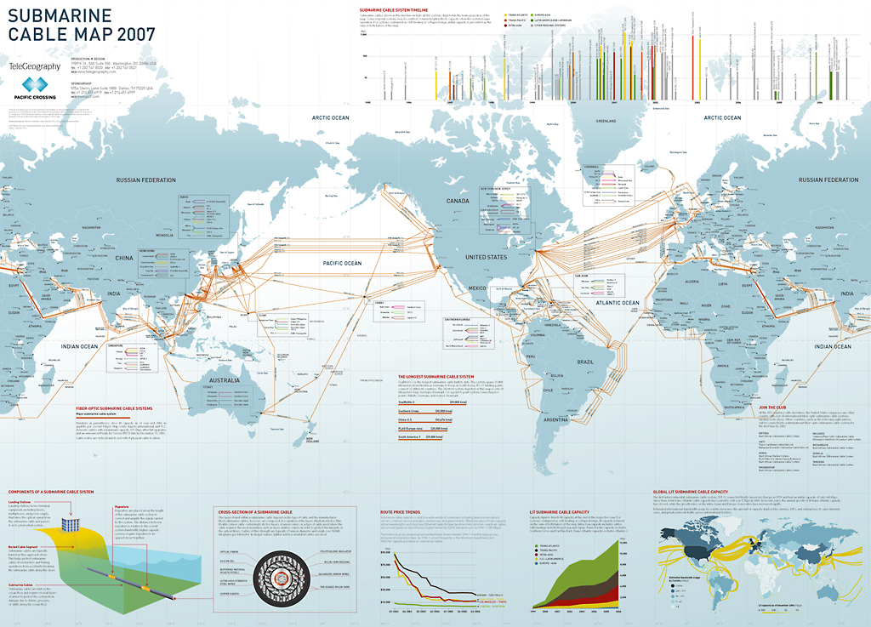
Submarine Cables

Slide 13
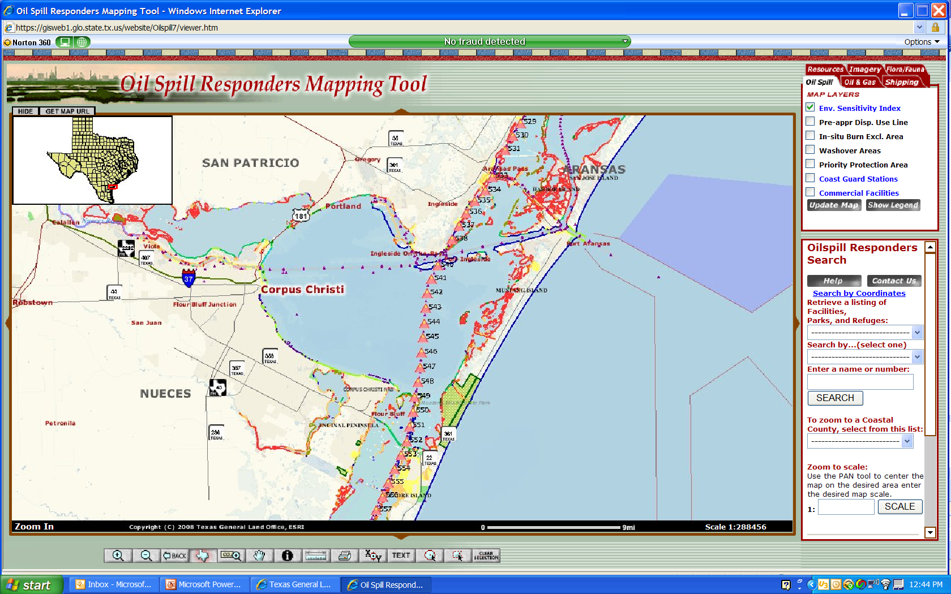
Our Focus will be on Prevention

Slide 14
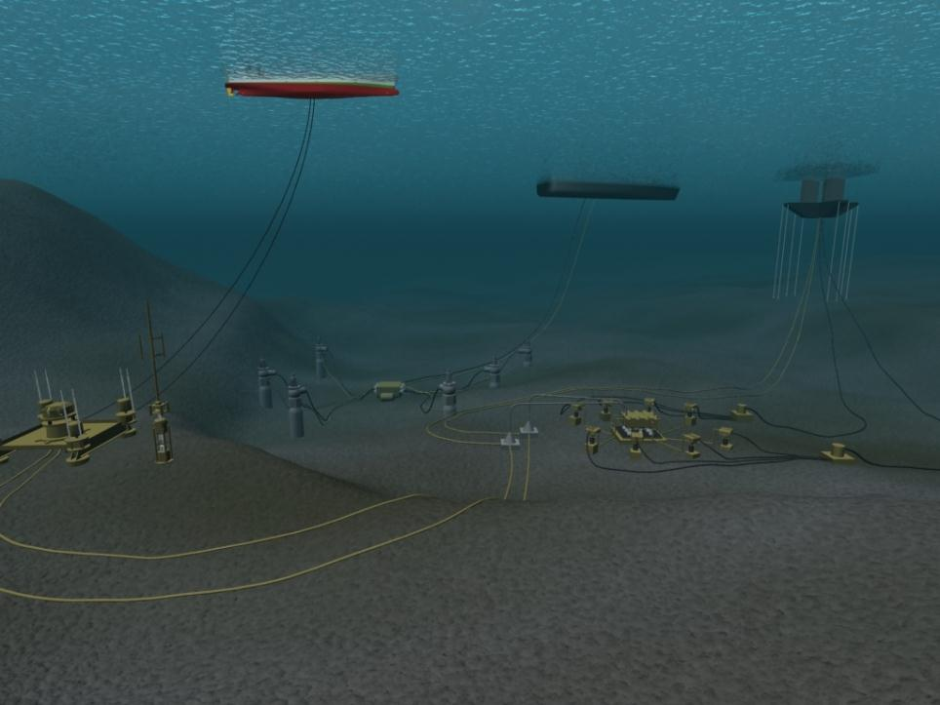
Lines from each platform extend over 18 miles in each direction in extreme instances over 50 miles
Shifting lines and extensive umbilical lines beyond the site of the platform provide and extensive network needing protection

Slide 15
GoM has 27,569 miles of pipeline as of June 2001 GoM now has 35,000 miles of pipeline and over 4,000 platforms
One Damage for every 4,300 miles of pipe annually

Slide 16
Pipeline Incidents
 | '96 | '97 | '98 | '99 | '00 | '01 | '02 | '03 | '04 | '05 | '06 | 07 | 08 | 09 YTD
GOM | 7 | 13 | 2 | 7 | 7 | 11 | 8 | 9 | 8 | 6 | 13 | 6 | 11 | 3
PAC | 0 | 0 | 0 | 1 | 0 | 0 | 1 | 0 | 0 | 0 | 0 | 0 | 0 | 0
Total | 7 | 13 | 2 | 8 | 7 | 11 | 9 | 9 | 8 | 6 | 13 | 6 | 11 | 3
One Damage for every 4,300 miles of pipe annually

Slide 17
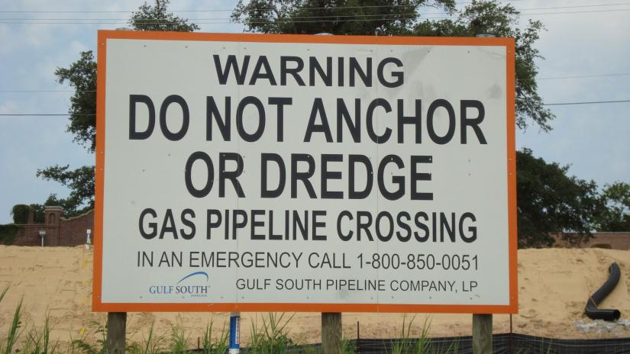
Onshore 811 Offshore GulfSafe.com

Slide 18
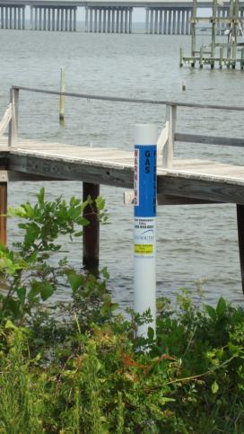
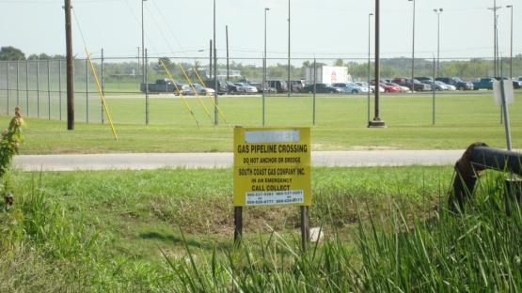
Onshore 811 Offshore GulfSafe.com

Slide 19
GulfSafe
Notification System needs to be in place before Offshore Drilling is expanded to East or West Coasts
Reassures the public that operators have their safety as a high priority

Slide 20
GulfSafe Notification System
Onshore 811 Offshore GulfSafe.com

