Slide 1
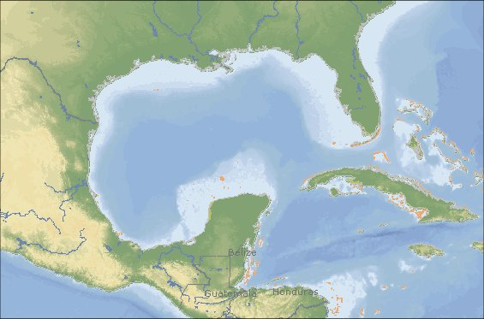
GulfSafe Notification System
1-888-910-GULF
www.gulfsafe.com
jackgarrett@gulfsafe.com

Slide 2
Coastal and Marine Third Party
Damage Incident DATA
The data below was compiled from PHMSA, Minerals Management Service, United States Coast Guard and the National Transportation Safety Board.
Interactions between Vessels / Anchors / Pipelines (1987 - 2007)
Pipeline Strikes Reported
118
Fatalities
25
Injuries
17
Environmental Impact from Pipelines Spills
100,000 bbls
Property Damage to Regulated
$100,000,000

Slide 3

Gulf of Mexico
Over 4,000 platforms
Over 33,000 active wells
Over 35,000 miles of pipeline
Thousands of miles of fiber optic network
International telecommunications
Sewer and water for near shore Islands

Slide 4
Protection For The Environment
Prevent release of Hydrocarbons
Improve design work for subsea installations
Improve communications between facility owners and work crews

Slide 5
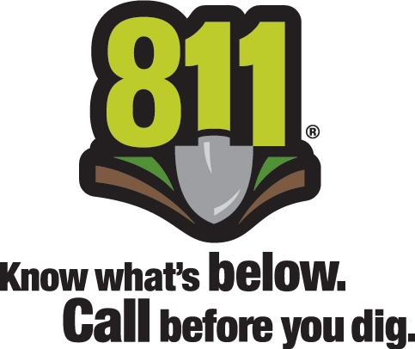
Onshore 811
Offshore GulfSafe.com

Slide 6
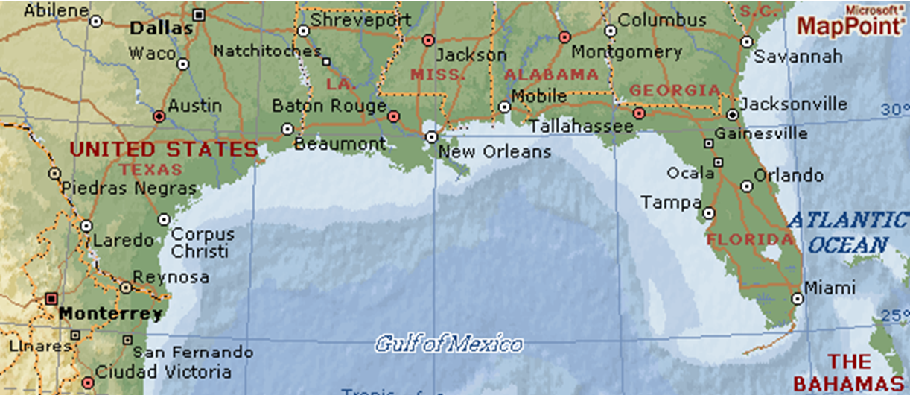
Working With Other One Calls

Slide 7
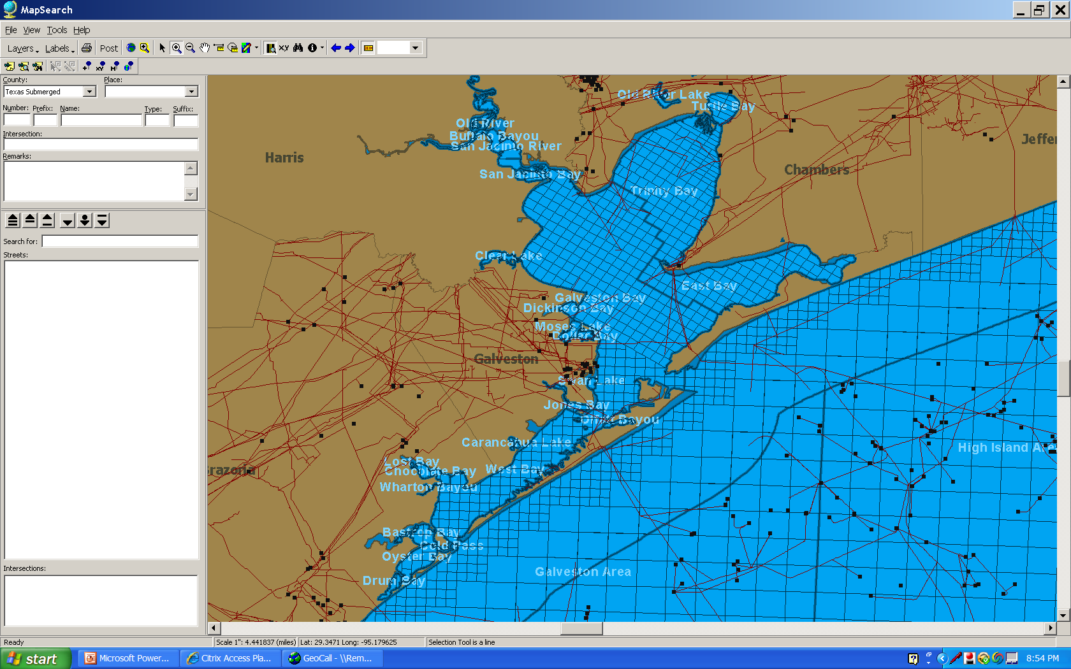

Slide 8
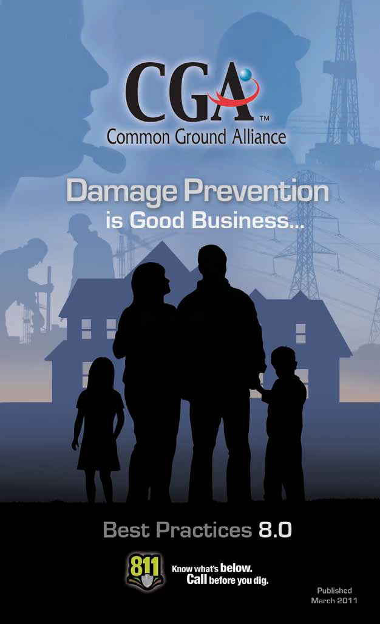
CGA
Best Practices
8.0
Published
March
2011

Slide 9
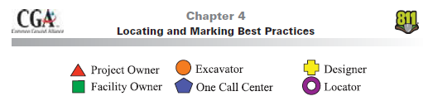
Best Practices are color coded for easy reference

Slide 10
4-20: Locating & Marking in Navigable Waterways
A. Permanent Markers for Underwater Facilities19
Practice Statement: Permanent markers are placed as close as practical at the entrance and exit point of facilities located underneath bodies of water where facilities are at risk of being damaged. For natural (and other) gas and hazardous liquids pipelines, these affected bodies of waters are “commercially navigable waterways” which have been defined in the Code of Federal Regulations (CFR)
Practice Statements & Description 35
20 TR-2004-04B: Amendment Approved by CGA Board on September 16, 2005.
21 TR-2008-02: Amendment Approved by CGA Board on March 3, 2010.
Paragraph 195.450 for hazardous liquids pipelines as “waterways
where a substantial likelihood of commercial navigation exists.”

Slide 11
Practice Description: Markers are used by underwater facility owners (e.g. cable, telecommunication, electric, water, sewer and oil/gas pipelines, etc.) to indicate the presence of an underwater facility in the area. There are many excavating activities (e.g. dredging, bridge construction, anchors, directional boring and other activities) that can damage these underwater facilities. The proper placement and maintenance of visible permanent markers raises the awareness of these facilities and reduces the likelihood of damage. Markers for underwater facilities follow the local, state and federal laws and regulations. Facility type, name and contact number of the
facility operator is included on markers for all facility types. In some cases the facility contact is the one call center. Markers include the words “Do Not Anchor or Dredge” and/or applicable warning language.
Benefits: By alerting excavators to the presence of underwater facilities, permanent shoreline markers provide additional protection to the excavators, facilities and the public.
References: Tennessee Gas: 1995 Procedures, OPS: 49 CFR 192.707, Sunshine State One Call of Florida, State of California Code, State of Delaware Code, State of Alabama Code, State of Mississippi Code
B. Temporary Markers for Underwater Facilities20
Practice Statement: Temporary markers are placed within the areas of proposed excavations as close as practical over facilities that are submerged in bodies of water where facilities are at risk of being damaged without impeding or creating additional hazards.

Slide 12
Practice Description: The technology used to locate and mark the submerged facility is dependent upon the size of the facility, depth of water, material composition of the floor and the depth the facility is positioned in or on the floor of the body of water. Temporary markers such as buoys, poles or PVC markers are used by underwater
facility owners to indicate the presence of an underwater facility in the area. At times these markers may be supplemented with mapping, GPS coordinates and/or fixed high bank marks. There are many excavating activities such as dredging, bridge construction,
setting of anchors and directional boring that can damage underwater facilities. The proper placement of visible temporary markers raises the awareness of these facilities and reduces likelihood of damage. Communication between stakeholders is initiated through the one call center to reduce potential conflicts. It is critical for stakeholders to maintain communication throughout the excavation to ensure the safe and successful completion of the project. Placement and removal of temporary markers for underwater facilities follow the local, state and federal laws and regulations.
Benefits: By alerting excavators to the presence of underwater facilities, temporary markers provide additional protection to excavators, facilities and the public.
References: Sunshine State One Call of Florida, State of California
Code, State of Delaware Code, State of Alabama Code, State of
Mississippi Code

Slide 13
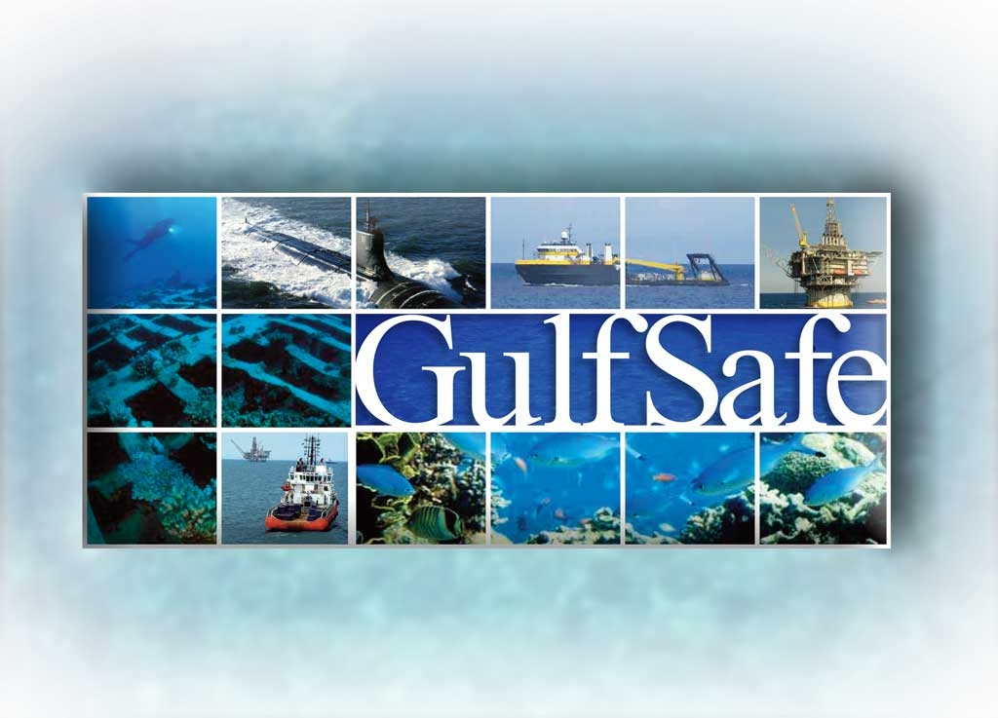
GulfSafe Notification System
Onshore 811
Offshore GulfSafe.com

